Slide 1

Preparation of Colourfull tiles from plastic wastage
DEPARTMENT OF CIVIL ENGINEERING
PRESENTED BY
G.ABHISLEM 20KQ1A0178
SK.FAHEEM 20KQ1A01B1
P.SIVAREDDY 20KQ1A01A6
O.SAISUNIL 20KQ1A0199
K.GOPI 20KQ1A0186
UNDER GUIDENCE OF
MR.A.SRUJAN KUMAR M.TECH
Asst. Professor

Slide 2
AGENDA
Introduction​
Classifications of plastic
Materials used
Methodology
conclusions
​

Slide 3
Introduction
Plastic can be reused in different sectors like manufacturing, marketing, transportation, construction site etc. Plastic is a very useful substance in our daily life work, but after the use of plastic it is very difficult for us to dispose of it because it is a non-biodegradable substance .The properties of plastic are very unique and it can mix with the every kind of material. Plastic is a composition of synthetic and semi synthetic organic compounds. They are ductile and remold into any solid substance. We need to use better advanced techniques and methods to dispose plastic waste properly.
as we use many types of tiles in construction field like, clay tiles etc. In this project we try to use plastic based tiles which have better characteristics than any other type of tiles. Plastic sand tiles are cheaper than the normal tiles. People can easily afford these types of tiles.

Slide 4
CLASSIFICATIONS OF PLASTIC
Polyethylene Terephthalate
High-Density Polyethylene
Polyvinyl Chloride
Low-Density Polyethylene
Polypropylene
Polystyrene

Slide 5
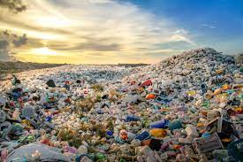
Plastic waste Waste plastic generated from waste elements of plastic bottles and figure shows a waste plastic for producing floor tiles.
MATERIALS USED

Slide 6
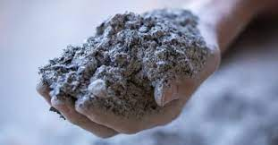
FLY ASH:-
Fly ash, a solid waste from thermal power plants has been a major source of environmental pollution. About 95 million tones of fly ash is being produced by the various power plants in the country.
FINENESS OF FLY ASH :-
the fineness of the fly ash is to be checked in both dry and wet sieving. The fly ash sample is sieved in 45 micron sieve and the percentage of retained on the 45 micron sieve is calculated. Further is also measured by LeChatelier method and Blaine specific surface method.

Slide 7
SPECIFIC GRAVITY OF FLY ASH:-
The specific gravity of fly ash ranges from a low value of 1.90 for a sub-bitumnious ash to a high value of 2.96 for an iron-rich bituminous ash.
Size and shape of fly ash:-
As the fly ash is a very fine material, the particle size ranges in between 10 to 100 micron. The shape of the fly ash is usually spherical glassy shaped.
Colour:-
The colour of the fly ash depends upon the chemical and mineral constituents. Lime content in the fly ash gives tan and light colours where as brownish colour is imparted by the presence of the iron content. A dark grey to black colour is typically attribitted to an elevated un-burned content.

Slide 8
METHODOLGY:-
PLASTIC COLLECTION
MELTING OF PLASTIC MATERIAL
MANUAL SORTING
MIXING OF MATERIALS
CHIPPING
PLACING OF RESIN
WASHING
DEMOULDING

Slide 9
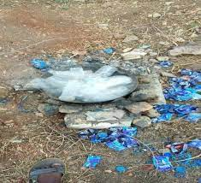
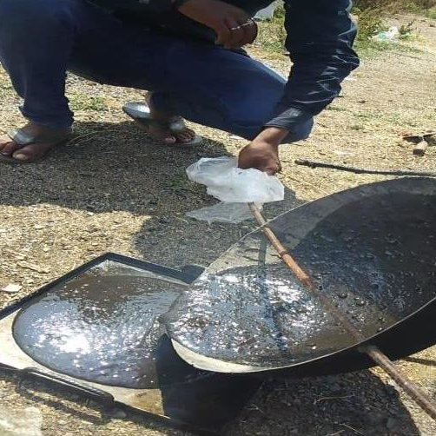
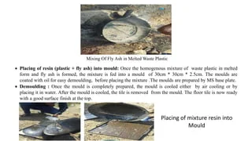
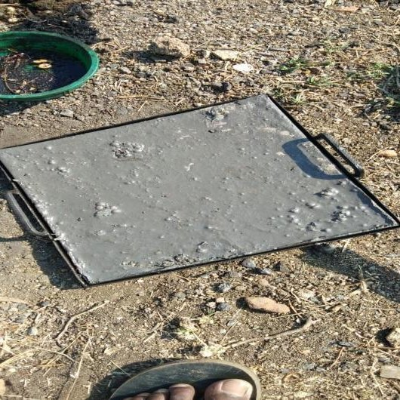
Arrangment of melting process
Placing of mixture resin into mould
Mixing of fly ash in melted waste plastic
Completely prepared mould

Slide 10
Conclusion :-
Waste plastic, which is available everywhere, may be put to an effective use in tile.
Plastic tiles can help reduce the environmental pollution, thereby making the environmental clean and healthy.
Water absorption of plastic tile is zero percent.
With reference to the literature and this study, plastic waste can be used as a binding agent instead of cement in the manufacturing of tiles, in the pavement construction etc.

Slide 11
THANK YOU
…

